Slide 1


Advanced Libraries In PYTHON
.
NAME:-Janvi Panchal
CLASS:-4_IT_B ENROLLMENT NO:-2302031000137 (063)

Slide 2
Introduction to Python Libraries
• Python has a wide range of libraries that extend its functionality.
• Libraries help with tasks like data manipulation, visualization, machine learning, web development, automation, and more.
• Built-in vs. third-party libraries.
Examples:
• Built-in: math, datetime
• Third-party: numpy, pandas, matplotlib, scikit-learn, etc
Why Use Advanced Libraries?
• Save development time and effort.
• Offer powerful pre-built functions.
• Efficient performance for handling large-scale tasks (data, ML, etc.)
• Community support and active development

Slide 3
Advanced Libraries are..
NumPy – Numerical Python
• Core library for numerical and scientific computing in Python.
• Supports large, multi-dimensional arrays and matrices.
• Provides high-performance mathematical functions like linear algebra, Fourier transforms, etc
pandas – Data Handling
• Offers powerful and easy-to-use data structures like Series and Data Frame.
• Helps in cleaning, transforming, and analyzing structured data.
• Can read/write data from different file formats like CSV, Excel, JSON, SQL, etc.
matplotlib – Visualization
• Comprehensive library for creating static, animated, and interactive plots. • Useful in presenting data insights visually.
• Common plots: Line, Bar, Histogram, Scatter, Pie, etc.
Pillow – Image Processing
• Fork of Python Imaging Library (PIL) for image processing.
• Supports image file manipulation including filtering, cropping, resizing, and format conversion.
• Can generate image-based visual effects or overlays.
TensorFlow – ML Framework
• Open-source library developed by Google for deep learning applications.
• Enables training and deployment of machine learning models on various platforms.
• Supports CPU, GPU, and TPU execution for scalability
Keras – High-Level ML API
• Runs on top of TensorFlow for easy neural network development.
• Offers a user-friendly interface with modularity and extensibility.
• Includes tools for building convolutional networks, LSTMs, and autoencoders.

Slide 4

What is NumPy?
Definition
Core Usage
Array Handling
NumPy, or Numerical Python, is a fundamental library for numerical computing in Python, widely used in scientific fields.
It supports Data Science, Machine Learning, and Simulation, making it indispensable for data practitioners.
NumPy provides efficient array structures, enabling complex calculations and operations with ease.

Slide 5


Why Do We Need NumPy?
1
Speed Issues
2
Performance Solution
Native Python lists can be slow and inefficient when dealing with large datasets or complex computations.
NumPy offers fast and memory-efficient n-dimensional arrays that enhance performance dramatically.
3
Library Foundation
Many libraries like Pandas, TensorFlow, and SciPy rely on NumPy, underscoring its importance in the Python ecosystem.

Slide 6



NumPy Architecture
Homogeneous Data
All elements in a NumPy array must be of the same data type, facilitating efficient memory usage.
2
High Performance
Built in C, NumPy ensures high-speed computation thanks to its core architecture.
1
Vectorization
3
Supports element-wise operations without explicit loops, reducing computational overhead and improving speed.

Slide 7
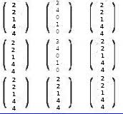

Creating Arrays
Basic Array Creation
Zeros and Spacing
Multi-dimensional Support
Simple commands like np.array([1, 2, 3]) create one-dimensional arrays.
Functions include np.zeros((2, 2)) for zero-filled arrays or np.linspace(0, 1, 5) for evenly spaced numbers.
NumPy supports 1D, 2D, and nD arrays for complex data structures, facilitating diverse applications.

Slide 8



Array Attributes
Type
2
The data type of the array elements is specified by dtype, ensuring computational efficiency.
Shape
Indicates the dimensions of the array, e.g., (3, 4) for 3 rows and 4 columns.
1
Dimension Count
3
ndim reveals the number of dimensions, while size tells the total number of elements in the array.

Slide 9

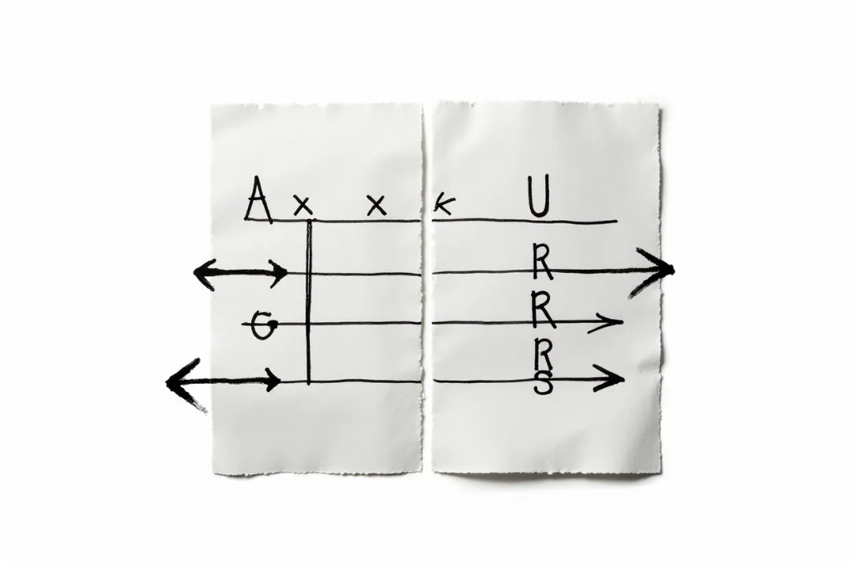
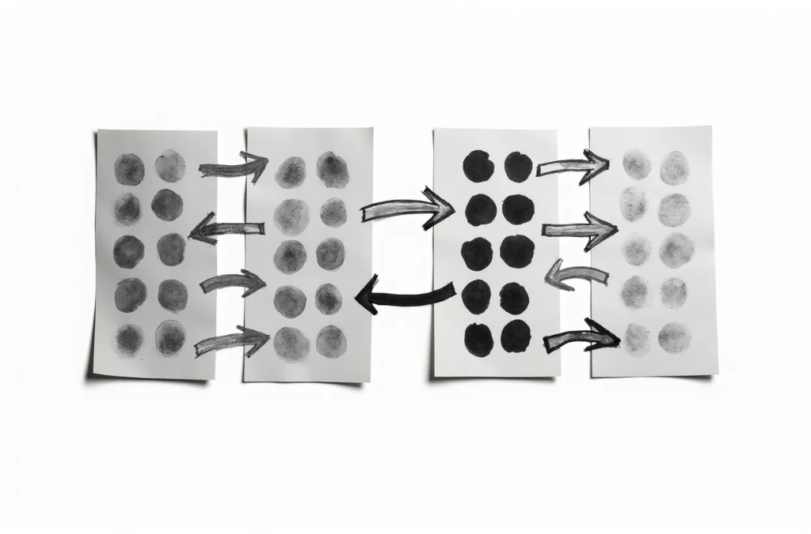
Indexing & Slicing in NumPy
Access Elements
Basic Commands
Flexibility
NumPy allows direct access and modification of array elements using indexing and slicing.
Examples include a[1:4] for slicing between indices and a[:, 0] for selecting entire columns.
Slicing provides powerful tools for convenient subarray manipulation, enhancing data processing capabilities.

Slide 10



Arithmetic & Operations
Aggregation Functions
2
Functions like np.sum() and np.mean() enable efficient calculations of aggregates across arrays.
Element-wise Calculations
1
Operations such as addition and multiplication are performed directly on arrays, simplifying code.
Efficiency
3
Performs operations on entire arrays rather than element-by-element, thereby optimizing runtime performance.

Slide 11

Understanding Broadcasting in Array Operations
Combining Shapes
Automatic Expansion
Example
Broadcasting allows different shaped arrays to interact seamlessly in operations, making array manipulation simpler.
Smaller arrays are 'stretched' to the shape of larger arrays, enabling straightforward computational tasks.
Adding a scalar to an array (a + b) automatically adjusts the dimensions for coherent arithmetic operations.

Slide 12




Universal Functions (ufuncs)
Element-wise Efficiency
Predefined Operations
These operations rapidly process each element of the array, yielding significant performance gains.
Wide Range
NumPy provides fast, vectorized operations for mathematical functions like np.exp() and np.sqrt().
Ufuncs cover numerous mathematical functions, enabling extensive numerical analysis.
2
1
3

Slide 13




Linear Algebra with NumPy
2
Matrix Operations
Additional capabilities include matrix inversion (np.linalg.inv()) and calculating determinants (np.linalg.det()).
Powerful Functions
NumPy supports linear algebra operations with functions like np.dot() for matrix multiplication.
1
Application
Effective for scientific computing, enabling complex computations in machine learning and other fields.
3

Slide 14
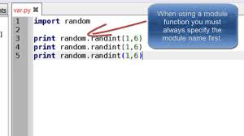
Random Numbers in NumPy
Random Generators
Variety of Types
Utility
Essential for various applications including simulations for machine learning and probabilistic models.
NumPy includes powerful functions for generating random numbers, useful in simulations and data analysis.
Functions like np.random.rand() produce random floats, while np.random.randint() yields random integers.

Slide 15
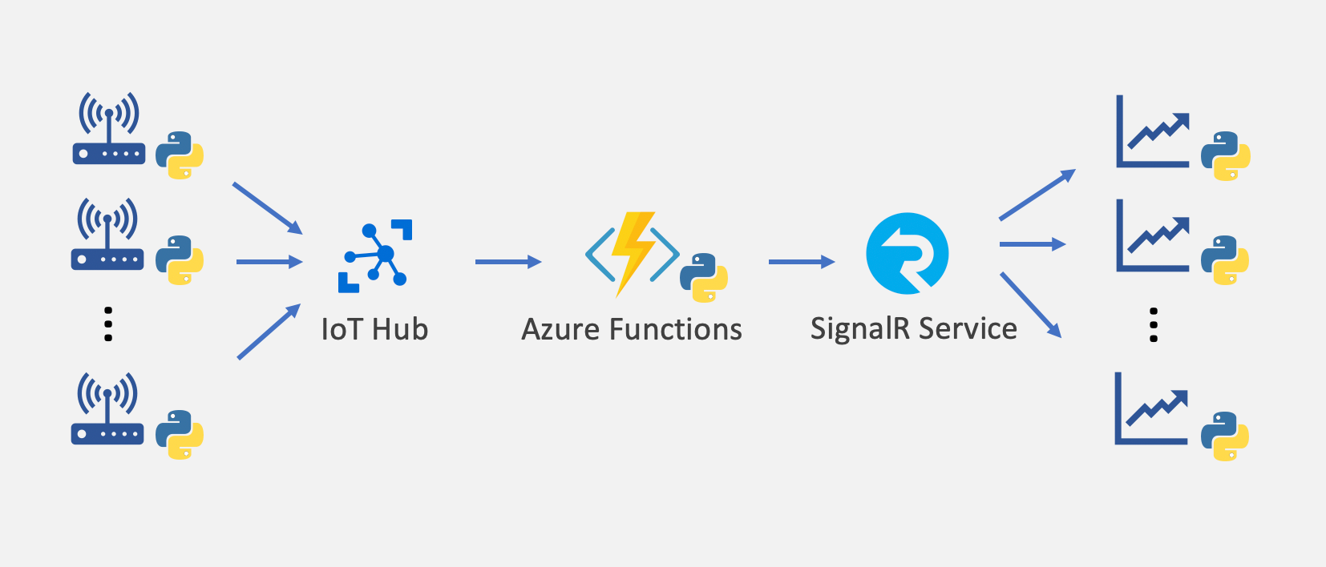
Real World Applications
1
AI/ML Usage
2
Finance Sector
3
Bioinformatics
Libraries like TensorFlow and PyTorch leverage NumPy for efficient array processing crucial in AI/ML tasks.
Utilized for data modeling and projections in financial analytics and risk assessment.
Assists in simulations and manipulation of biological data, such as DNA sequence analysis.

Slide 16
NumPy vs Other Libraries
Functional Scope
While Pandas offers data manipulation tools, NumPy supports a broader array of operations and mathematical functions.
2
Speed Comparison
NumPy outperforms Python lists in speed, making it suitable for high-performance applications.
1
Memory Efficiency
3
NumPy arrays are designed to be more memory-efficient compared to standard Python lists, optimizing resource usage.

Slide 17
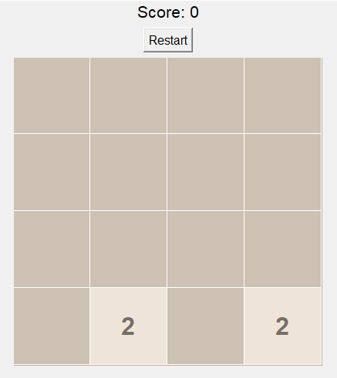
Mini Project: 2048 GAME
Game UI Design
Built using Tkinter (Python GUI library)
Shows a 4x4 grid on a canvas
Each tile has a color and number
Score label displays points
Restart button to start a new game
Game Logic
Tiles move using arrow keys (Up, Down, Left, Right)
Same-number tiles merge (e.g., 2+2=4)
Score increases when tiles merge
Objective: Reach the 2048 tile
After Each Move
A new tile (2 or 4) appears at random empty spot
The board updates with new tile positions
Game checks:
Win: 2048 tile appears
Game Over: No more valid moves

Slide 18
GITHUB LINK:-https://github.com/Jhanvi2505/PYTHON/tree/main/Assignment-3
THANK YOU

